Slide 1
Tips for Effective PowerPoint Presentations
A Speaker’s Guide to the 2018 National Conference on Ending Family and Youth Homelessness

Slide 2
Tips To Be Covered
Agenda Slide
Slide Format and Transitions
Fonts and Font Size
Graphs
Spelling and Grammar
Presentation Style
Conclusion
Questions

Slide 3
Agenda
Make Your 2nd slide an agenda of your presentation
Example: See previous slide
Follow the order of your agenda for the rest of the presentation
Only place main points on agenda slide

Slide 4
Slide Format
Use one slide for every 2-3 minutes
Write in bullet points
No more than 6 words per bullet
No more than 6 bullets per slide
No more than 6 consecutive slides with text
Avoid wordiness: Use key words and phrases only

Slide 5
Slide Format -Bad
This page contains too many words. It is not written in bullet point form, making it difficult both for your audience to read and for you to present each point. There is one less bullet point on this slide as the previous slide, but it’s much more complicated. Your audience will spend too much time trying to read this paragraph instead of listening to you.
Also, Don’t Capitalize Each Word
Punctuate rarely; only complete sentences

Slide 6
Slide Transition and Animation- Bad
Stay away from distracting animation
Don’t overdo any animation or transitions you choose to use
Be consistent with the animation that you use

Slide 7
Fonts - Good
Please use large fonts!
Use at least a 26-point font, and try to stick with a 28-point font or larger
Use different size fonts for main points and secondary points
This is a 26-point, the main point font is 32-point, and the title font is 44-point

Slide 8
Font Color- Good
Use a color of font that contrasts sharply with the background
EX: Black font on white background
Use color to reinforce the logic of your structure
EX: Blue title and black text
Use color to emphasize a point
But only use this occasionally

Slide 9
Font Color - Bad
Avoid the following:
Using a font color that does not contrast with the background color is hard to read
Using color for decoration is distracting and annoying
Using a different color for each point is unnecessary
Using a different color for secondary points is also unnecessary
Trying to be creative can also be bad

Slide 10
Graphs - Good
Use graphs rather than just charts and words
Data in graphs are easier to comprehend and retain than raw data
Trends are easier to visualize in graph form
Always title your graphs

Slide 11
Graphs - Good

Slide 12
Graphs - Bad

Slide 13
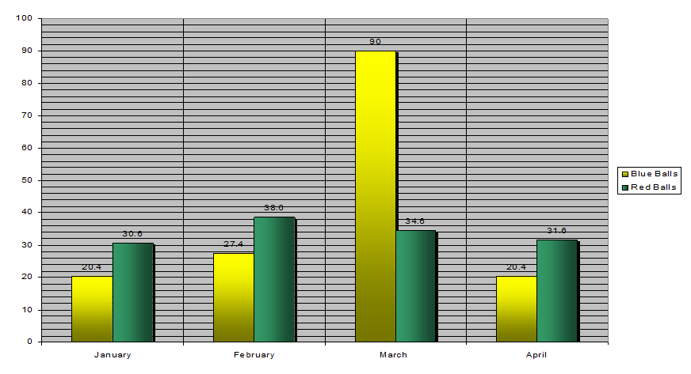
Graphs - Bad

Slide 14
Graphs - Bad
Problems with the Bad Graph
Minor gridlines are unnecessary
Font is too small
Colors are illogical
Title is missing
Shading is distracting

Slide 15
Spelling and Grammar
Proof your slides for:
Speling mistakes
The use of of repeated words
Grammatical errors you might have make
Correct spelling but wrong word (you/your; won/one; your/you’re)
Avoid A&A (that’s short for acronyms and abbreviations)
Have someone else check your presentation!

Slide 16
Presentation Style
Use slides as discussion starters, but keep from reading them
Slides should support your presentation
Use photos, graphics, charts, graphs, bullet points, and minimal text to help support your presentation points
Stand when you present
Use the microphone when available
Remain in your allotted time

Slide 17
Conclusion
Use an effective and strong closing
Your audience is likely to remember your last words
Use a conclusion slide
Summarize the main points of your presentation
Suggest future avenues of research

Slide 18
Questions?
End presentation with a simple question slide
Invites audience to ask questions and avoids ending a presentation abruptly

Slide 19
Additional Information
All presentation information or handouts must be submitted to the Alliance by Wednesday, February 21, 2018 at kkenney@naeh.org
Use a blank slide to end the show or include your contact information, like the one that follows…..

Slide 20
Thank You
If you have further questions, please contact:
Katie Kenney at kkenney@naeh.org.

