Slide 1
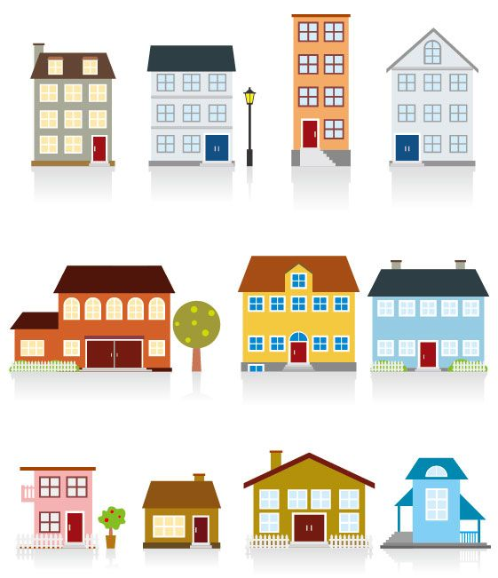
MUST Ministries
Rapid Re-Housing
Case Managers
Counties We Serve:
Cobb
Cherokee
Bartow
Pickens
Paulding
Douglas
CM: Kendra Moore
770-790-3904
kmoore@mustministries.org
CM: Latoya Inzar
770-790-3914
linzar@mustministries.org
1407 Cobb Pkwy
P.O. Box 1717
Marietta, GA 30061
Created: 2-2018
What is Rapid
Re-Housing?

Slide 2
FIND housing
PAY for housing
STAY in housing
HELP people quickly find housing within one month or less
GOAL:
FIND and secure housing as quickly as possible after a person/ family becomes homeless
HELP pay for housing while individuals/families become self-sufficient
GOAL:
BUILD relationships with Landlords to have access to as many units as possible
HELP access services (employment, budgeting, education, etc.) so individuals/families can stay in home
GOAL:
LIMIT the time individuals/families spends homeless
FOR APPROVAL
Benefits 4 Landlords?
Landlords receive timely rent payments including security deposits
Benefits 4 Landlords?
Reduction of vacant units
Decrease advertising costs
Benefits 4 Landlords?
Assistance from case managers to the client/family and is the Landlord’s immediate contact

