Slide 1

The Emergency Shelter
Learning Series
Which Rules are the Right Rules?
Part II: Serving Single Adults in Low-Barrier Emergency Shelters
Notes:
Cynthia

Slide 2
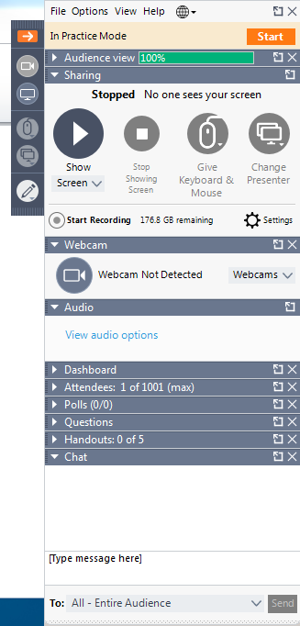
Today’s Webinar
Please note that all lines are on mute.
Please pose questions at any time in the Questions box. We will try to get to as many as we can at the end.
The webinar and slides will be posted following the presentation. Feel free to share with your staff and any other stakeholders.
Ask a Question!
Notes:
Kristi
Before we begin, here are some logistics to know about today’s webinar.
Please note that because of the large amount of attendees, all lines are on mute.
Please pose questions at any time in the Questions box. We will try to get to as many as we can if there is time remaining at the end but because of the high volume of attendees, we may not be able to answer all of your questions. We will continue to respond to frequently asked questions over the series.
The webinar and slides will be posted following the presentation. Feel free to share with your staff and any other stakeholders.

Slide 3
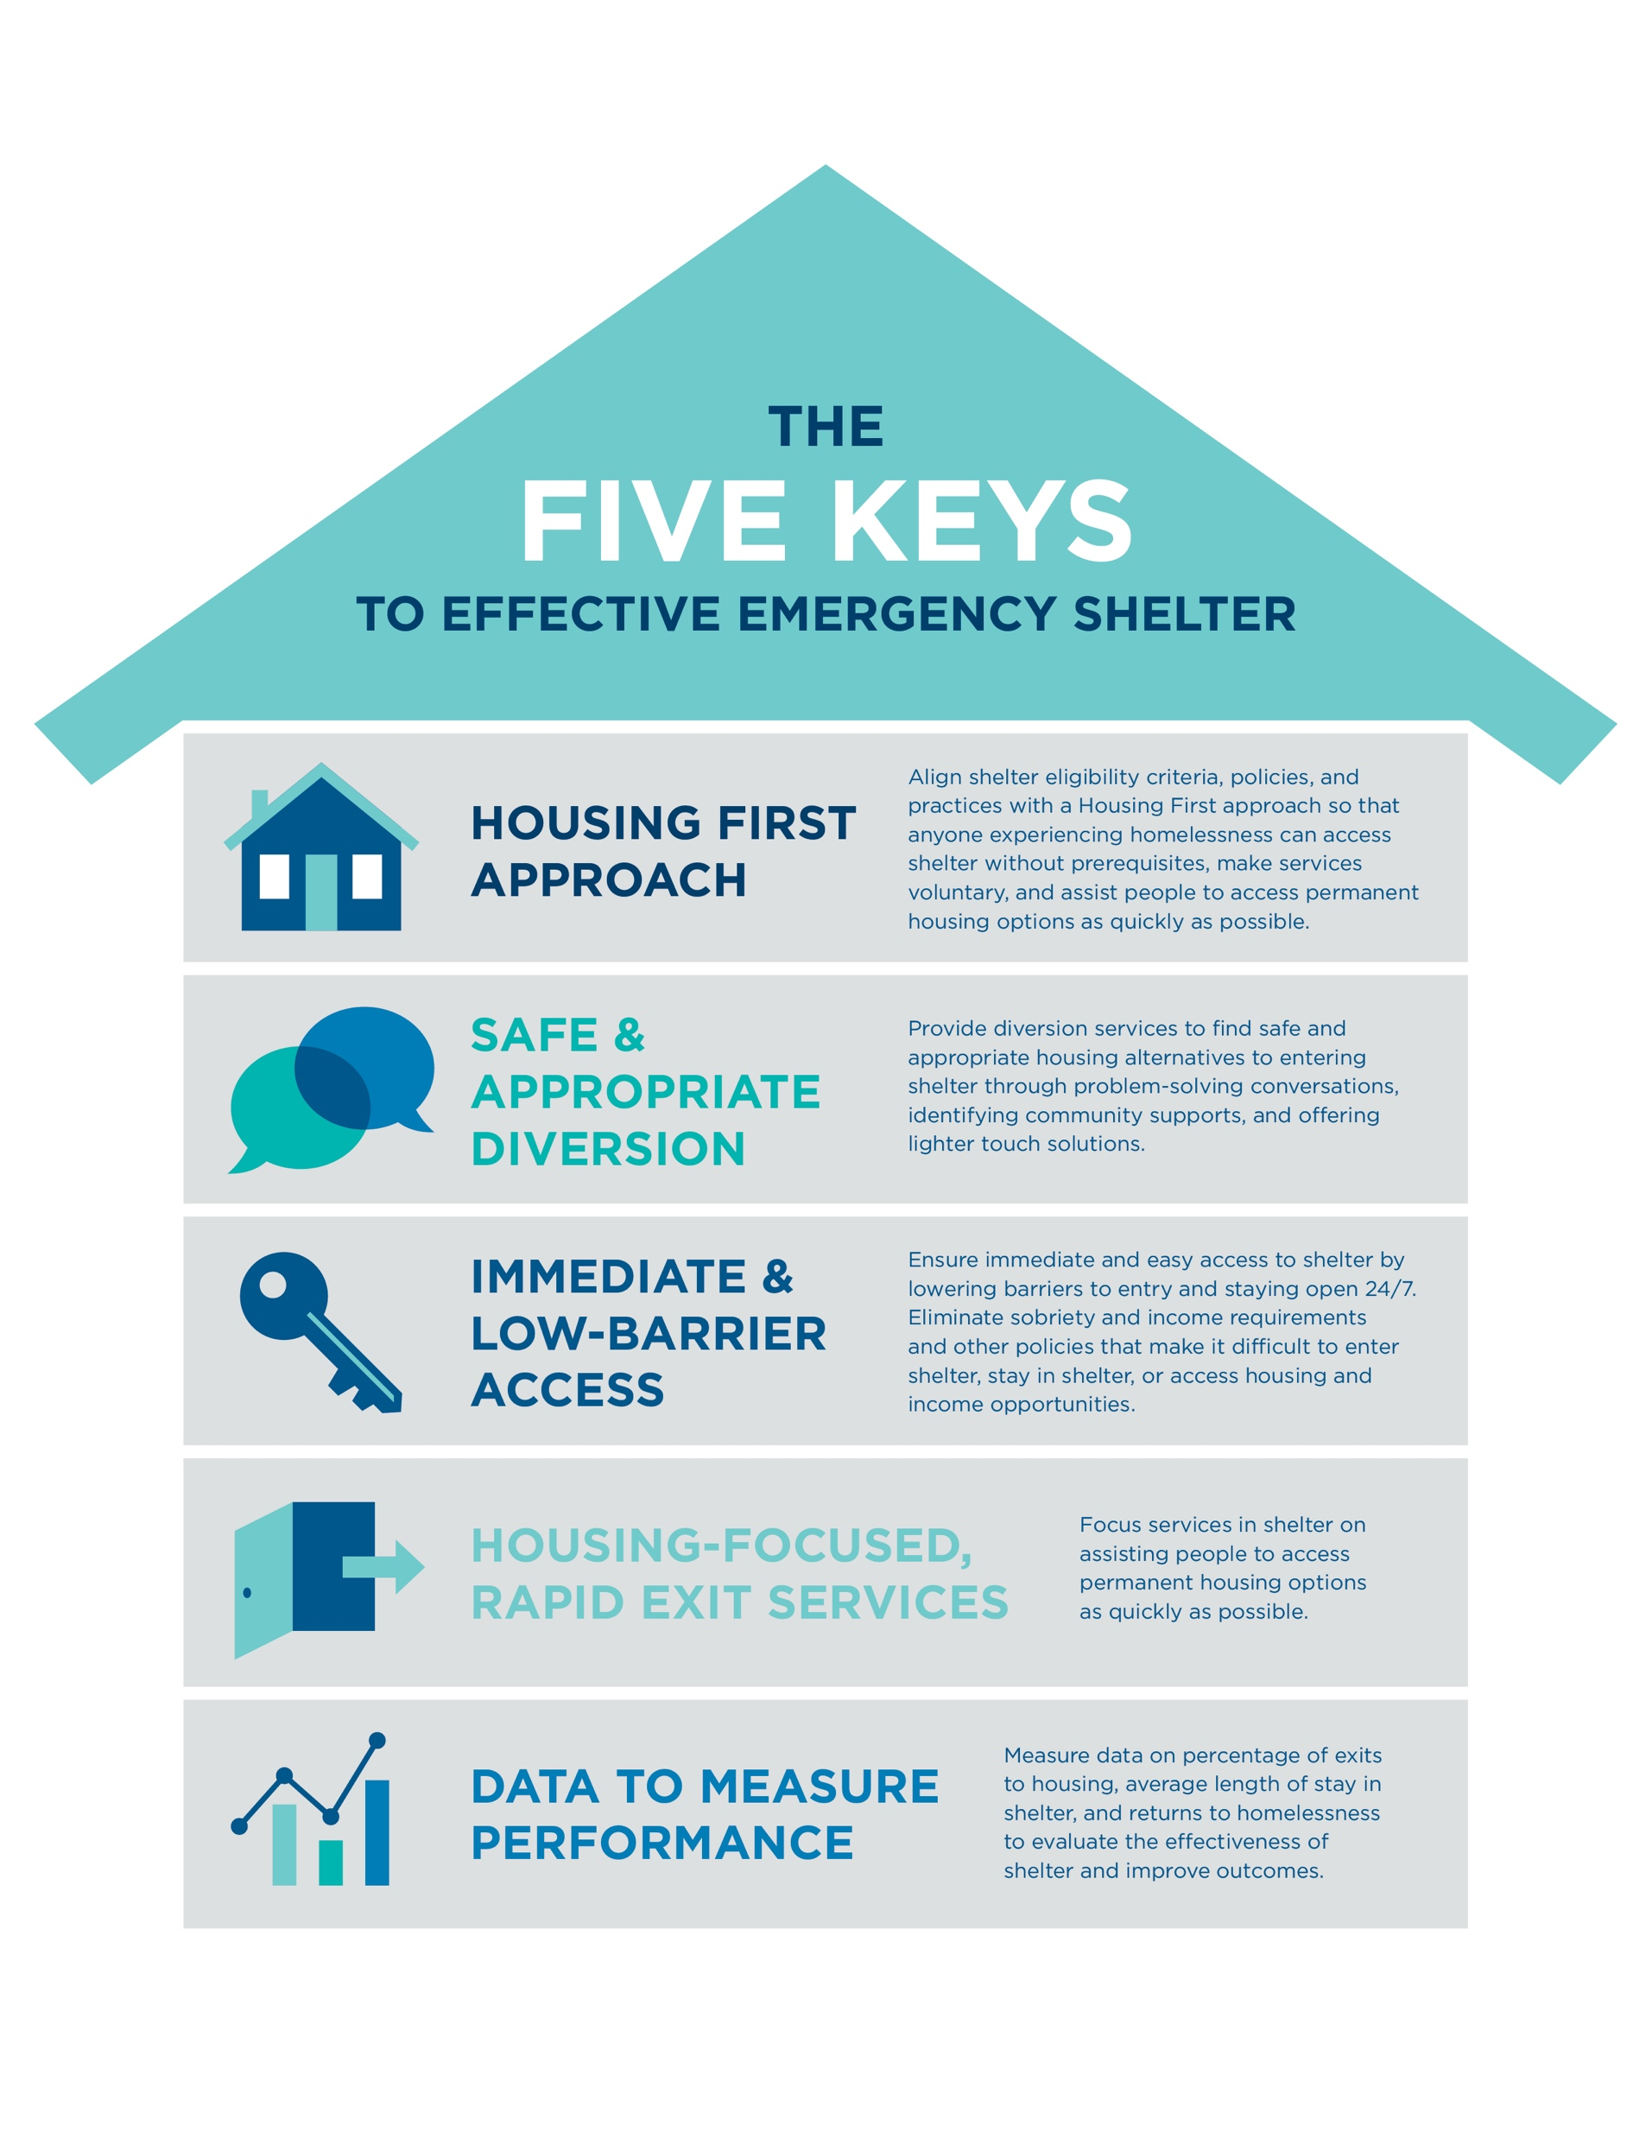
Today’s Speakers
Ben Cattell Noll
TA Specialist
Center for Capacity Building, NAEH
Cynthia Nagendra
Director
Center for Capacity Building, NAEH
Katherine Hammer
Division Director- Homeless and Residential Services
The Lewis Center, Palm Beach County
Liz Werley-Prieto Duffie
Project Manager
Downtown Emergency Services Center (DESC) Shelter Program, Seattle
Notes:
Ben
I’m Ben Catell Nolll, TA specialist at the Alliance’s Center for Capacity Building.
I am joined today by the Director for the Center, Cynthia Nagendra, and we are very fortunate to have two fantastic panelists from the field, Katherine Hammer from the Lewis Center in Palm Beach County and Liz Duffie, Project Manager at the Downtown Emergency Services Center in Seattle to share their experience and guidance from operating and working with emergency shelters. They will tell you more about themselves shortly.
We are really excited to continue the emergency shelter learning series with today’s webinar.
With that, I will hand it over to Cynthia to tell you more about today’s webinar and the shelter Learning Series.

Slide 4

Notes:
Amazing! We’re the best at what we do!
We are on a path towards improvement and transitioning our current model.
We are doing ok, could use some guidance on how to improve.
We are struggling to operate an effective shelter that ends homelessness for most people.
We feel totally lost. Help!

Slide 5

Why Are Shelters So Important?
Emergency shelters and other types of crisis housing (crisis beds, interim housing, motel vouchers) play a critical role in your system’s response to homelessness
People in a housing crisis will always need a safe and decent place to go that is immediately available
Notes:
Cynthia
Thanks for attending today’s webinar.
Why are we talking about shelters so much lately? – because shelters are extremely important and almost every community has one as a response to homelessness. Sometimes it is a community’s only or primary response to homelessness.
So Shelters and other types of crisis beds are critical to the functioning of an effective crisis response system because People who have housing crises need a safe and DECENT place to go. Without this, a community will not be able to make homelessness rare, brief, and non-recurring. All shelters in a community do not need to be low-barrier, BUT every community needs some low-barrier shelters so that everyone has a place to go that needs a bed, especially if there are people who are living on the street or other places not meant for human habitation.

Slide 6

Emergency Shelter Learning Series
Overview
Series of webinars
Key elements to operating an effective shelter
Self-assessments to evaluate your shelter
Tools that your shelter can use to implement programmatic, policy, and operational changes
Guidance from shelters that have made the transition to a more effective shelter model
Notes:
Cynthia
We want to acknowledge that operating an emergency shelter is very important, difficult and often life-saving work. This series is meant to help communities and shelters build on the very important work that shelters already do to respond to homelessness and shift practice in ways that will benefit people experiencing homelessness as well as help communities to take a systems and housing-focused approach to providing emergency shelter services. We also want to acknowledge that change is really hard and doing things differently can be very anxiety-provoking. However, we hope you will hear about strategies and experiences from other shelters to make your work easier, more rewarding, and ultimately improve outcomes for people experiencing homelessness in your community. We have already heard from many of you that you are already seeing positive outcomes from the changes you are making and welcome you to share any feedback as you make these transitions to your programs. Through this series and associated tools and guidance, we hope to get you started and feel supported in making the changes you want to make to improve the outcomes for the people that you serve.
Series of webinars
5 Key elements to operating an effective shelter
Self-assessments and action planning templates to assess your shelter chart out the steps you need to implement the 5 keys
Tools that your shelter can use to implement programmatic, policy, and operational changes
Guidance from shelters and other experts that have made the transition to a new shelter model
You can directly download the tools we have shared from the webinar resources. At the end, we will send you a link to an online survey that includes the same self-assessment questions that you can print and use to action plan as well. We encourage you to use the online assessments or the downloaded assessments to assess where your shelter currently is before the next webinar in May.

Slide 7
Emergency Shelter Learning Series
Goals
Strengthen shelter policies and services to improve the housing outcomes for people experiencing homelessness across your crisis response system
Implement a system-wide approach to ending homelessness that includes emergency shelters
Align emergency shelters’ goals with the community’s goals to end homelessness
Provide enough low-barrier, safe, and housing-focused shelter
Notes:
Cynthia
The primary goals of this series are to help communities:
Strengthen shelter policies and services to improve the housing outcomes for people experiencing homelessness across your crisis response system
Implement a system-wide approach to ending homelessness that includes emergency shelters
Align emergency shelters’ goals with the community’s goals to end homelessness
Provide enough low-barrier, safe, and housing-focused shelter. The webinar series is not meant to just be informative but also intended to guide shelters to action and accomplish the following activities during the course of the series so that you may build on the great work you are already doing to solve homelessness in your community by aligning your shelters with these recommended practices.

Slide 8
Emergency Shelter Learning Series
Resources
https://endhomelessness.org/resource/emergency-shelter/
Past Webinars in the Series
1. The Role of Shelter in the Crisis Response System
2. The Keys to Low-Barrier Effective Shelter
3. How to Transition Your Shelter
4. Which Rules are the Right Rules Part I (DV and Family Shelters)
Notes:
Cynthia
This learning series on emergency shelters is the fifth webinar in the series. There has been a really great response in terms of attendance and we really appreciate the feedback and the questions we have been getting over the last few months. Your feedback has helped to shape the series a lot as we want to make sure we are responding to your questions and interests. If you want to go back and watch past webinars and download the various tools that we have shared, please do so at this address.

Slide 9






Notes:
Cynthia
Throughout this series we have been talking about how to re-tool shelters by aligning your shelter with these 5 key elements.
The 5 key elements to effective emergency shelters are:
Having a Housing First Approach
Practicing safe and appropriate diversion
Ensuring your shelter provides immediate and low-barrier access
Making your shelter housing-focused, with rapid exits TO HOUSING services
And using your data to measure your shelter’s effectiveness and make shelter design decisions
Today we will be focused on how to operate a shelter that has a low-barrier environment and housing-focused services but still prioritizes safety for clients and staff.

Slide 10
Today’s Webinar
Which rules, expectations, and guidelines are the “right” ones in a low-barrier and housing-focused shelter?
How do you continue to prioritize safety of shelter participants and staff in a low-barrier environment?
How can you ensure safety within shelters that serve single adults in medium to large congregate settings?
How can you help staff and other community stakeholders make this transition?
Notes:
On today’s webinar, which will focus on maintaining safety and having expectations and rules in a low-barrier environment, we will discuss the following questions:
Which rules, expectations, and guidelines are the “right” ones in a low-barrier and housing-focused shelter?
How do you continue to prioritize safety of shelter participants and staff in a low-barrier environment?
How can you ensure safety within shelters that serve families with children?
How can you ensure safety within shelters that serve survivors of domestic violence?
While the guidance can apply broadly, our panelists will be particularly focusing on shelters serving families and survivors of domestic violence. On next month’s webinar, we will be focusing rules and expectations in shelter environments that serve single adults or have large congregate settings.

Slide 11
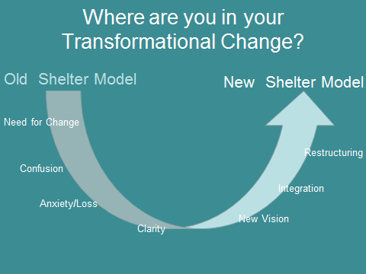
Notes:
Cynthia
Throughout the webinar series, we have been asking you where you find yourself on this scale of transformational change.
Many of you might be on the left side of the scale starting to recognize a need to change because what you’re doing isn’t working as well as you want. It is likely that you will go through these various stages of change as you work through this process of transforming your shelter...confusion, anxiety/sense of loss because you’re changing the way you have worked for so long, eventually arriving at clarity to develop a new vision and integrate into a new shelter model. And, it might not take as long as you think!

Slide 12
Notes:
Ben
Poll
So – where do you find yourself in your transformational change?

Slide 13
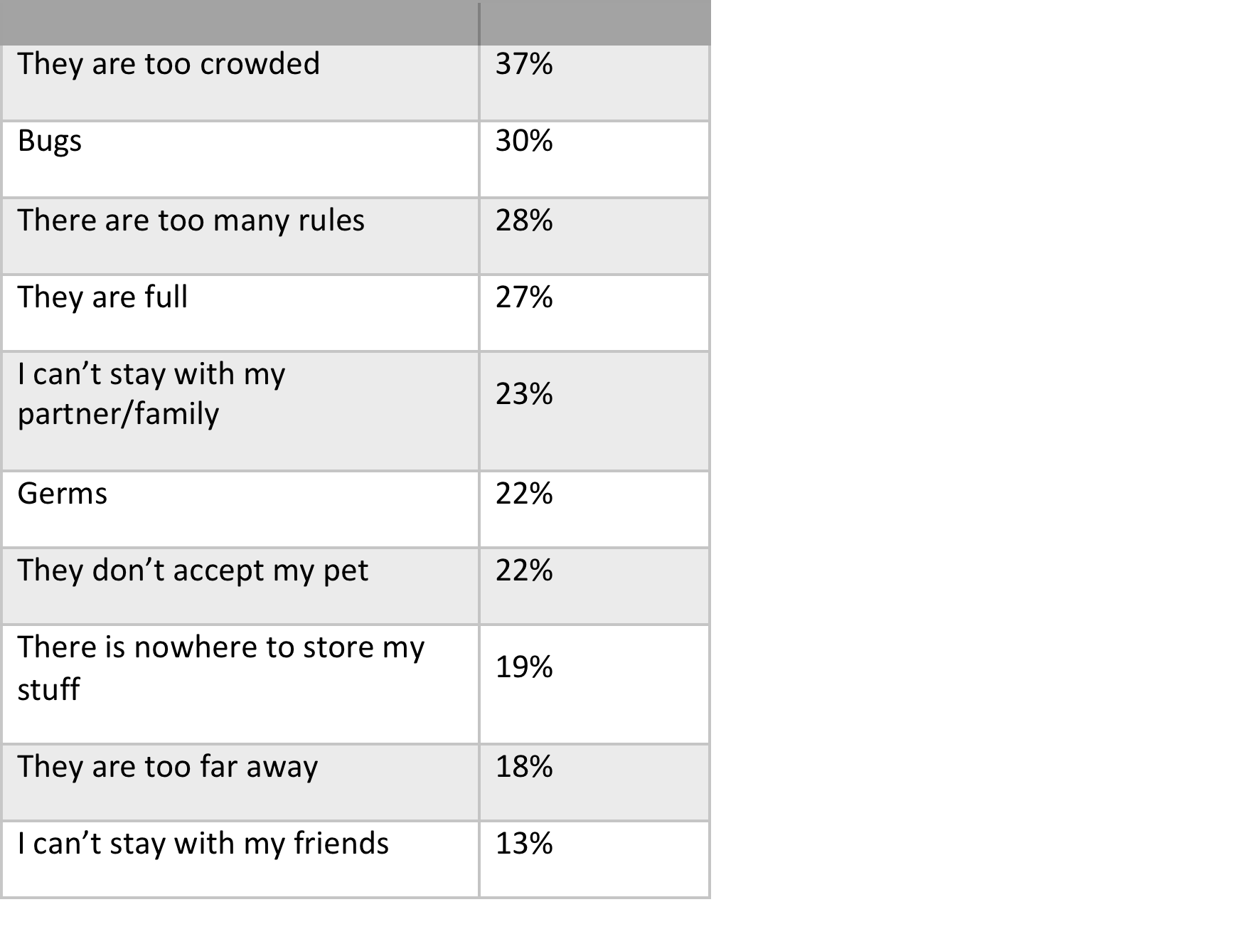
Why Do People Avoid Shelters?
Notes:
One of the important things we have learned from many communities is why people avoid shelters. This helps to inform how shelters should shape their environments to better respond to the needs of people experiencing homelessness.
This is from a survey of unsheltered people in Seattle who were not engaging with shelter services. As you can see, 28% said there are too any rules. This is representative of other like surveys we have seen from other communities around the country. If you would like to better understand how people utilize or don’t use your community’s shelter services, we encourage you to do a survey of consumers inside shelter and people who are living outside that do not want shelter. It could greatly illuminate things about your shelters that you are not aware of.
Try to imagine how people who are coming into shetler are feellng, the stress related to crisis and trauma they may likely be experiencing, and how it feels to be handed a long list of complicated and overly restrictive rules.
In November 2016, more than 1,050 unique surveys were completed with individuals experiencing homelessness in the city of Seattle. The survey was then supplemented by six targeted focus groups, held with roughly 80 individuals representing different subpopulations within the city. recruitment was designed to reach targeted subpopulations identified by the city including youth, families with children, those who stay in authorized encampments, those who stay in unsanctioned encampments, persons in emergency shelters, and those who sleep in vehicles. Here are the results.

Slide 14
Low-Barrier No Rules
Notes:
Cynthia
However, this doesn’t mean don’t have ANY rules.
People often equate “low-barrier” with “NO RULES”
“Low-barrier does NOT mean “no rules” –
Let me emphasize this very important point –Low-barrier does not mean there are no rules.

Slide 15

How To RETool Your Rules
Notes:
Cynthia
So, which rules are the right rules to have in a low-barrier environment and how do you re-tool the rules, guidelines, client handbooks, etc that you have?
Before we go into this, I’m going to turn it over to Kristi to see what the audience thinks about rules

Slide 16
Notes:
If you are a shelter provider, does your shelter require:
Sobriety/Drug and Alcohol Tests
Criminal background check
Income/Savings
Belongings to be searched
None of the above - we are low-barrier

Slide 17
The Role of Rules
Why do you have rules?
Which rules are needed to operate your emergency shelter?
How can a shelter promote safety without creating unnecessary barriers to services and housing?
Notes:
So what is the role of rules in a shelter?
Why do you have rules?
Well, it seems that when you ask people who work in shelters, rules are mainly about keeping people safe and maintaining a community environment that is comfortable, safe, and equitable for all.
However, many rules create unnecessary and often unintended barriers to getting in, staying in, and even getting out of shelter to a positive outcome. WE want to get rid of those barriers and still maintain a safe and decent environment.

Slide 18
“
Sometimes I feel like a child, with everyone watching my every move. It’s not a good feeling and it makes me feel like I did something wrong by being homeless.
-Consumer
Notes:
This quotation is from a qualitative study done on families staying in shelter that is an example of what parents in shelter sometimes feel.
A shelter with too many rules can feel punitive and institutional. Why would we treat people experiencing homelessness differently than anyone else? Is it because they did something wrong? Or is it because we just assume having a lot of rules is good for everyone? What if we approached the idea of rules in a totally different way and thought about what expectations the community should be setting for everyone to maintain comfort, safety, and empowerment?

Slide 19

Are your program rules
a barrier
to people being able access or stay in shelter?
Notes:
The key question you want to ask yourselves: Are your program rules a barrier to shelter?

Slide 20
Retooling the Rules
Rules Expectations
Notes:
Cynthia
It might be helpful to reframe the whole notion of rules and re-frame them as community expectations. This has a whole different ring to it, feels less about compliance or about being punitive, and more about the expectation of a safe and comfortable community environment.

Slide 21

Retooling the Rules
DO promote safety.
DO NOT try to change or
control people or their
behaviors.
-Iain De Jong, OrgCode Consulting
Notes:
Cynthia
Iain De Jong, the CEO of ORgCode, has a very effective way of talking about the role of rules that I’m going to quote here. Rules should promote safety. They should not try to change or control people or their behaviors, because people are adults and the job of shelters is not to try and change or control behaviors. Once you start to separate safety from controlling or changing behaviors, you might see your rules, client handbooks, and policies very differently.

Slide 22
Retooling The Rules: Do Promote Safety
Focus on respect in behaviour, not punishment for actions
Use a trauma-informed approach
Use restrictions and barring sparingly, and always connect people to alternative resources as best as possible
Know your own values and beliefs; but, not impose those on others
Accept people without judgment
Treat guests’ belongings respectfully
Encourage access to basic needs like hygiene with dignity
Reinforce the strengths of each person
Talk about housing and community integration
Be transparent in how decisions are made with guests, not about them
Circulate frequently throughout the shelter and actively engage with guests to encourage housing and promote hope
Be sensitive to the power of your position
-Iain De Jong, OrgCode Consulting
Notes:
These are also words of wisdom from Iain DeJong-
Focus on respect in behavior, not punishment for actions
Use restrictions and barring sparingly, and always connect people to alternative resources as best as possible
Know your own values and beliefs; but, not impose those on others
Accept people without judgment
Treat guests’ belongings respectfully
Encourage access to basic needs like hygiene with dignity
Reinforce the strengths of each person
Talk about housing and community integration
Be transparent in how decisions are made with guests, not about them
Circulate frequently throughout the shelter and actively engage with guests to encourage housing and promote hope
Be sensitive to the power of your position

Slide 23
Changing/Controlling Behavior or
Promoting Safety?
Sobriety
Searching Belongings
Criminal History
Weapons
Curfews
Chores
Case Management
Permanent Barring
Notes:
Are your rules trying to change or control people’s behavior or truly promoting safety? Do you really need all these rules to maintain safety or do they just give you the feeling of being safe, rather than actually make anyone safer? Is it deterring people who really need your services from coming into your shelter? A
You decide!
Look at your rules pertaining to
Sobriety
Searching Belongings
Criminal History
Weapons
Curfews
Chores
Case Management
Permanent Barring

Slide 24

Retooling the Rules
The “Marvin” Rule
Notes:
Another thing to think about.
Do you sometimes look at your rules and wonder where some of them came from?
Did you ever have an incident happen with a client that freaked you out so much that you made a specific rule to address the incident so that it would never happen again?
Like, maybe a man named Marvin happened to have a lighter in the bathroom because he was trying to smoke a cigarette after curfew and accidentally set the toilet paper on fire?
And instead of telling people not to smoke, or allowing people to go out to smoke at night, you banned all lighters and search people’s belongings for lighters?
Well, we call those Marvin rules. Look at your rules and see how many Marvin rules you have that really don’t make sense outside of that one incident and get rid of them!

Slide 25
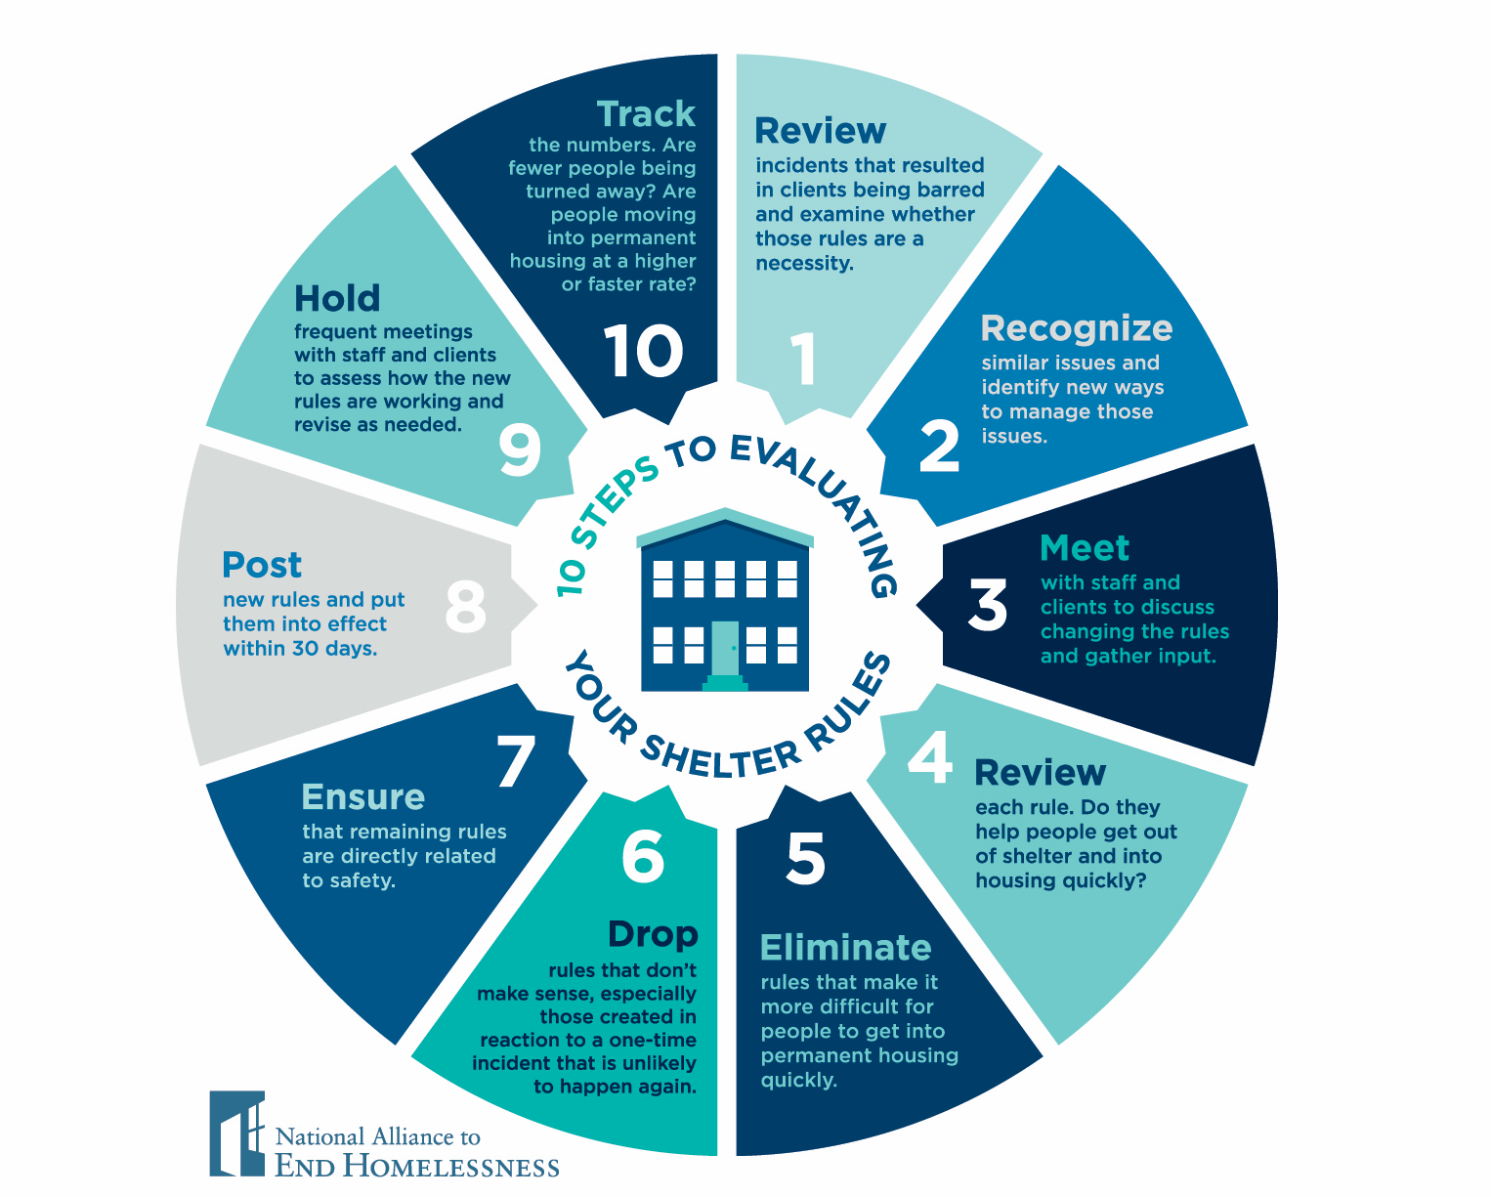
Retooling the Rules
Notes:
Cynthia
So, take a look at all your rules, guidelines, client handbooks, written materials, and ALL signage in your shelter and ask yourself:
Review incidents resulting in clients being barred
Recognize similar issues that could be handled in other ways
Meet with staff and clients to discuss changing the rules and gather input
Review each rule for whether it helps people get out of shelter into housing - or whether it inhibits this from occurring quickly?
Eliminate rules that make it more difficult for people to get into housing
Drop rules that don’t make sense, especially those created in reaction to a one time incident that is unlikely to happen again
Rules that remained should be directly related to safety
Post new rules and let them take effect in 30 days
Hold frequent meetings with staff and clients to assess how the new rules are working and revise as needed
Track if the number of people barred decreases

Slide 26
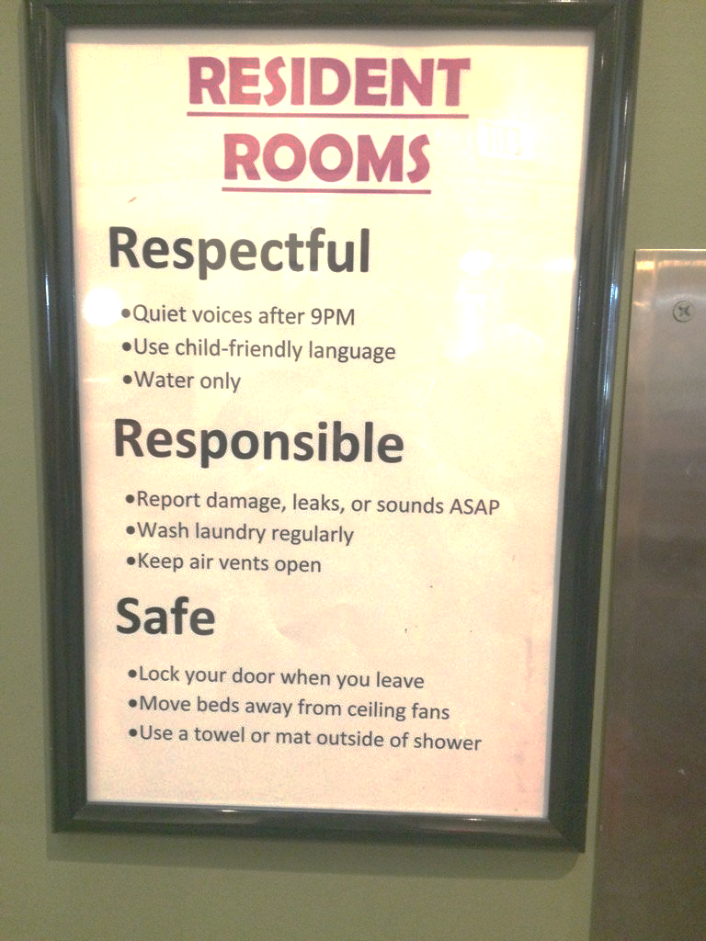
Retooling the Rules
Notes:
This is an example from a shelter we have visited. They threw out their pages of rules and put this up instead.
The new expectations can be very minimal and still convey that the community expects people to be respectful, responsible, and safe.

Slide 27

Contact Us!
Cynthia Nagendra
Ben Cattell Noll
The Center for Capacity Building
Email: thecenter@naeh.org
Notes:
Items needed: Post it notes
Each person is asked to identify one thing they will do to implement learnings into their shelter, community/program within the next week.
Ask for volunteers to share.
Assignment – put post it note on your computer or somewhere where you can see it and mark it on your calendar for one week from today to see if you have completed it. Then assign your self one more thing to do in the next week – keep doing every week until your community has implemented best practice crisis response emergency shelter/crisis housing.

Slide 28
Notes:
Ben
Have you been changing the rules since listening to this webinar series?
1)Yes, we have re-written all of our rules and lowered barriers to shelter
2)Yes, we have re-written some of our rules
2)No, we have not re-written any of our rules but we are thinking about doing it and need help
3)No, we have not re-written any of our rules because we don’t need to
4)No, we have not re-written any of our rules because our Board/Staff/Community won’t let us

Slide 29
Transitioning from
High to Low Barrier Shelter
From Start to Finish
Katherine Hammer
The Lewis Center
Palm Beach County, Florida

Slide 30

Moving from Social Control to
Partnership with Those Served

Slide 31
About the Lewis Center…
Single Adult Overnight Shelter
Palm Beach County

Slide 32
Lewis Center: Before
Sample of Rules
Drug Testing at entry and whenever suspected drug or alcohol use
AA Meetings required
Attend Life Skills Group
Assessed for mental health prior to entry
If using substances or drinking, won’t be referred to Rapid Re-Housing
No public displays of affection
Anyone returning inebriated will be denied entry
Guests will be required to go to detox if they return under influence of drug or alcohol; individuals who refuse will not be able to return to shelter for period of no less than 30 days

Slide 33
Lewis Center: Before
Consequences to Rules
Break a rule, receive a “Personal Improvement Plan” (PIP)
Receive 3 personal improvement plans you will be exited
Come back drunk/high results in being exited from shelter
This model created power struggles between staff and guests with focus on receiving a PIP and not on real issues of housing

Slide 34
Lewis Center: After
Transition to Low-Barrier
Eliminated/Changed the following rules:
  Drug testing
  Required attendance to AA and Life Skills groups
  Stopped all rules related to sobriety
  Curfew

Slide 35
Lewis Center: After
Expectations
HAVE A HOUSING PLAN
Keep alcohol and drugs off property
Respect people sleeping by being quiet after 10pm in the rooms
No weapons on site for safety
Treat people with kindness

Slide 36

Staff Reactions: Then
Complaints to my supervisor - “I am going to get Kat fired. Surely, no one knows what she is doing over here.”
“Does this mean we are going to let addicts stay here?”
“How are we going to maintain control?”
“Does that mean people can do what they want?”
“How are we going to manage people with no rules?”
“This place will be a zoo.”
Etc.

Slide 37
What Happens Instead
If a guest is struggling with an issue of concern i.e. being under the influence of substances every day…
  Staff, a director, and the guest meet to discuss how it affects the housing plan and what might be possible consequences.
  We provide support and redirection to importance of obtaining housing.

Slide 38
Staff Reactions: Now
“My job is easier without fighting about whether or not someone is high.”
“I feel I can spend more time assisting people without having to argue about a PIP.”
“The place feels nicer.”

Slide 39
Data
Before Shelter Transition 10/1/15 - 9/30/16 | After Shelter Transition 10/1/16 - 9/30/17
Admissions = 418 Individuals Rapidly Rehoused = 76 Average Length of Stay= 56 days High VISPDAT (10+) individuals on acuity list November 2016 = 75 | Admissions = 447 Individuals Rapidly Rehoused= 145 Average Length of Stay= 50 days VISPDAT Score (10+) individuals on acuity list November 2017 = 36

Slide 40

Liz Duffie
Project Manager
DESC Shelter Program
Seattle, Washington
ewerley-prieto@desc.org

Slide 41

About DESC
Single adult overnight shelter
  Specific focus on serving
    Women
    People age 60+
    People with a physical disability or chronic illness
    Mental health condition/psychiatric disorder
    Chemical dependency
  120 beds for men, 80 for women
    Clients self-identify preference based on their gender identity
Day services
  Shower, mail, phones, walk-in case management, clothing, referrals, medical care

Slide 42
Staffing
4-5 Shelter Counselors (50-80:1 ratio)
  Entry-level job
  3 shifts to cover 24-hour operations
Support Staff (Monday-Friday, 9-5)
  Project Manager
  Project Assistant
  Case Managers (4)
  Nurse
  Mental Health Case Managers (4)
Challenge: Turnover!

Slide 43
Staff Training
CPI Crisis Prevention and Response
CPR
Naloxone Administration
Shelter Policies and Procedures
  How to respond when a rule is violated
  When it is and is not appropriate to bar a client
  Making decisions in gray areas

Slide 44
Safety and Security
No Security Guards at any DESC site
  Uniformed guards would be a deterrent and a barrier to many clients
  Limited access through front door (buzz in)
No metal detectors, “wanding” or bag screenings
  Weapons are prohibited from the shelter and the rule is enforced if item comes into view

Slide 45
Handling Difficult Situations
Give Choice Whenever Possible
  If client is found with banned substances: Do you want to dispose of the substance or leave?
Practice Your Approach
  Know how to explain “low barrier”
  Don’t be caught off-guard when you need to enforce

Slide 46
Handling Difficult Situations
Approach Clients with Caution
  No security or screening method is 100% effective
  Security screenings can create a false sense of safety
Avoid Threatening Barring Whenever Possible
  Don’t threaten unless you have decided barring is necessary
  Wording Matters!
    “I may have to ask you to leave the shelter if…”

Slide 47
Discussion Questions and Your Challenges

Slide 48
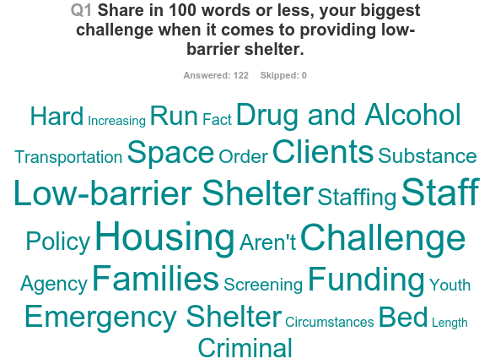
Your Challenges

Slide 49
Your Challenges: Substance Use
“
How do we help people who are trying to stay sober while allowing people who are under the influence of substances into the same space? Isn’t that going to be a trigger for people who are trying to be sober?
How do we keep people safe when some people are intoxicated? Especially if we serve people in a congregate setting?

Slide 50
Your Challenges:
Staff Capacity
“
One of our biggest challenges is having adequate staff to operate a low-barrier shelter and help individuals stay focused on a housing plan.
How do we help people who are having mental health issues or substance issues exit to housing if we don’t have a lot of staff or have enough skilled staff?

Slide 51
Your Challenges: Community
Buy-in
“
We are bought into a low-barrier shelter model but our board and community do not want us to have a ”wet” shelter. How do we get buy-in?

Slide 52
Your Challenges: Hours of Operation
“
It will be hard to get people to do the stuff they need to do if we let them hang around all day in shelter, so we ask them to leave during the day. Why is it a problem to ask people to leave early in the morning and come back in the evening to get their bed?

Slide 53

What’s Next
Webinar in December, TBD
Evaluating Shelter’s Performance with Data
Notes:
Register for the next webinar!
The Keys to Effective
Low-Barrier
Emergency Shelters
May 17, 2017

Slide 54
Contact Us!
Cynthia Nagendra
Ben Cattell Noll
The Center for Capacity Building
Email: thecenter@naeh.org

